Slide 1


<Denver G. Magtibay>
<January 2023>

Slide 2

Outline
Executive Summary
Introduction
Methodology
Results
Conclusion
Appendix

Slide 3
Executive Summary
In the era of commercial space exploration, SPACE Y is on a mission to make space travel a reality for everyone. Born from the belief that the wonders of the universe should be within reach, we are committed to redefining accessibility in space exploration.
Methodologies:
Data Collection: Curating Comprehensive Datasets Through API Integration and Web Scraping
Data Wrangling: Meticulous Data Cleaning, Structuring, and Refinement
Exploratory Data Analysis (EDA): In-Depth Analysis with SQL, Pandas, and Matplotlib
Interactive Visual Analytics and Dashboard Creation: Engaging Stakeholders with Folium and Plotly Dash
Predictive Analysis (Classification): Informed Decision-Making through Machine Learning Models
Results:
Optimized Hyperparameters: Identifying the Best Hyperparameters for Each Classification Algorithm
Performance Assessment: Determining the Superior Method through Test Data Evaluation

Slide 4

Introduction
In this project, we're exploring a cool space idea: figuring out if SpaceX's Falcon 9 rocket's first stage will land safely. You see, SpaceX is known for its cost-friendly rocket launches, only about 62 million dollars, way less than what others charge, which can go over 165 million dollars. The trick? SpaceX can reuse the first stage of the rocket. So, if we can predict whether that first stage will land well, we can figure out how much a launch will cost. This info is super handy if another company wants to compete with SpaceX for a rocket launch. So, buckle up for a journey into predicting space success and making space travel more wallet-friendly!

Slide 5

Section 1

Slide 6
Methodology
Executive Summary
Data Collection Methodology:
Data gathered from SpaceX REST API and web scraping from wiki pages.
Data Wrangling:
Convert collected data (JSON, HTML) into a Pandas dataframe for visualization and analysis.
Exploratory Data Analysis (EDA):
Load data into a database.
Execute SQL queries for data selection and sorting.
Conduct EDA using Python and Pandas, creating scatter plots and bar charts for analysis.
Interactive Visual Analytics (Folium and Plotly Dash):
Build an interactive map with Folium to analyze launch site proximity.
Use Plotly Dash to create an interactive dashboard containing pie charts and scatter plots.
Predictive Analysis (Classification Models):
Train different classification models.
Split data into training and testing sets.
Perform grid search to find optimal hyperparameters.
Utilize machine learning to build a predictive model for Falcon 9 rocket landings.

Slide 7
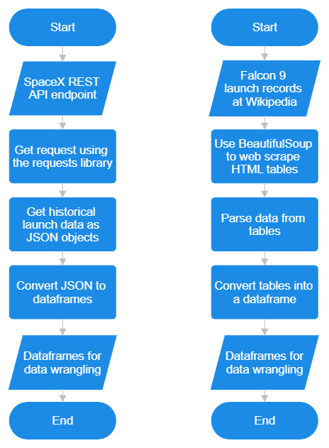
SpaceX API
Web Scraping
Data Collection
The data collection involved retrieving information from both the SpaceX REST API and conducting web scraping on relevant wiki pages.

Slide 8
Data Collection – SpaceX API
Data Collection - SpaceX API
1. SpaceX REST API endpoint
2. Get request using the requests library
3. Extract information about booster name, launch site, payload mass and landing site
4. Get the past launch data as a JSON object
5. Convert the JSON to a dataframe
6. Filter the dataframe to only include Falcon 9 launches
7. Deal with missing values
8. Data wrangling
Data Collection API Notebook:
https://github.com/WarDen-Git/testrepo/blob/main/jupyter-labs-spacex-data-collection-api.ipynb

Slide 9
Data Collection - Scraping
Request the Falcon 9 Launch Wiki page from its URL.
Create a BeautifulSoup object from the response.
Extract all column/variable names from the HTML table header.
Create a data frame by parsing the launch HTML tables.
Conduct data wrangling to enhance the structure and quality of the collected data.
Data Collection Scraping Notebook:
https://github.com/WarDen-Git/testrepo/blob/main/jupyter-labs-webscraping.ipynb

Slide 10
Data Wrangling
Identify missing values.
1
Differentiate numerical and categorical columns.
2
Calculate the count of launches for each site.
3
Determine the count and occurrences of each orbit.
4
Assess the count and occurrences of mission outcomes per orbit type.
5
Generate a landing outcome label based on the information in the outcome column.
6
Data Wrangling Notebook:
https://github.com/WarDen-Git/testrepo/blob/main/labs-jupyter-spacex-Data%20wrangling.ipynb

Slide 11
EDA with Data Visualization
Flight Number vs. Payload Mass
Scatter Plot
To explore any potential correlation between the flight number and payload mass, identifying trends or patterns over multiple launches.
Flight Number vs. Launch Site
Scatter Plot
To visually analyze if there's any clustering or grouping of launches at different sites over the course of multiple flight numbers.
Payload Mass vs. Launch Site
Scatter Plot
To examine how payload mass varies across different launch sites, identifying any notable differences or trends.
Orbit Type vs. Success Rate
Bar Chart
To compare the success rates for different orbit types, providing a clear overview of mission outcomes.
Flight Number vs. Orbit Type
Scatter Plot
To visualize the distribution of different orbit types over various flight numbers, revealing patterns or shifts in mission objectives.
Payload Mass vs. Orbit Type
Scatter Plot
To explore the relationship between payload mass and orbit type, identifying potential dependencies or preferences.
Year vs. Average Success Rate
Line Chart:
To observe trends in the average success rate over the years, providing insights into the overall performance and progress of SpaceX launches.
EDA with Data Visualization Notebook:
https://github.com/WarDen-Git/testrepo/blob/main/jupyter-labs-eda-dataviz.ipynb

Slide 12
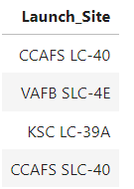
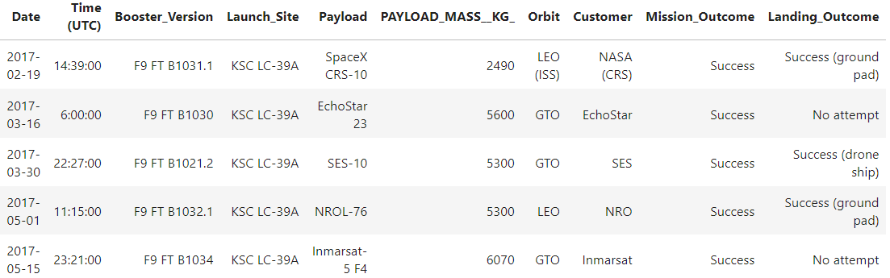
EDA with SQL
SQL Queries:
1. Display the names of the unique launch sites in the space mission
%sql SELECT DISTINCT Launch_Site FROM SPACEXTABLE;
2. Display 5 records where launch sites begin with the string 'KSC'
%sql SELECT * FROM SPACEXTABLE WHERE Launch_Site LIKE 'KSC%' LIMIT 5;
EDA with SQL Notebook:
https://github.com/WarDen-Git/testrepo/blob/main/jupyter-labs-eda-sql-edx_sqllite.ipynb

Slide 13
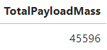
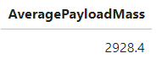
EDA with SQL
SQL Queries:
3. Display the total payload mass carried by boosters launched by NASA (CRS)
%sql SELECT SUM(PAYLOAD_MASS__KG_) AS TotalPayloadMass FROM SPACEXTABLE WHERE Customer = 'NASA (CRS)’
4. Display average payload mass carried by booster version F9 v1.1
%sql SELECT AVG(PAYLOAD_MASS__KG_) AS AveragePayloadMass FROM SPACEXTABLE WHERE Booster_Version = 'F9 v1.1'
EDA with SQL Notebook:
https://github.com/WarDen-Git/testrepo/blob/main/jupyter-labs-eda-sql-edx_sqllite.ipynb

Slide 14
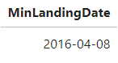
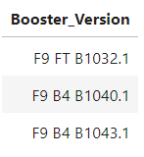
EDA with SQL
SQL Queries:
5. List the date where the successful landing outcome in drone ship was achieved.
%sql SELECT MIN(Date) AS MinLandingDate FROM SPACEXTABLE WHERE Landing_Outcome = 'Success (drone ship)’
6. List the names of the boosters which have success in ground pad and have payload mass greater than 4000 but less than 6000
%sql SELECT Booster_Version FROM SPACEXTABLE WHERE Landing_Outcome = 'Success (ground pad)' AND PAYLOAD_MASS__KG_ > 4000 AND PAYLOAD_MASS__KG_ < 6000
EDA with SQL Notebook:
https://github.com/WarDen-Git/testrepo/blob/main/jupyter-labs-eda-sql-edx_sqllite.ipynb

Slide 15
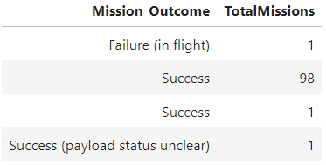
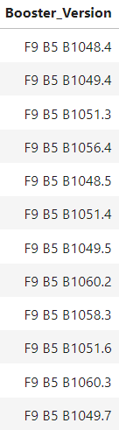
EDA with SQL
SQL Queries:
7. List the total number of successful and failure mission outcomes
%sql SELECT Mission_Outcome, COUNT(*) AS TotalMissions FROM SPACEXTABLE GROUP BY Mission_Outcome;
8. List the names of the booster_versions which have carried the maximum payload mass. Use a subquery
%sql SELECT Booster_Version FROM SPACEXTABLE WHERE PAYLOAD_MASS__KG_ = (SELECT MAX(PAYLOAD_MASS__KG_) FROM SPACEXTABLE);
EDA with SQL Notebook:
https://github.com/WarDen-Git/testrepo/blob/main/jupyter-labs-eda-sql-edx_sqllite.ipynb

Slide 16
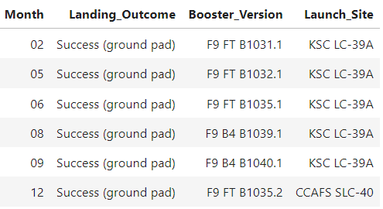
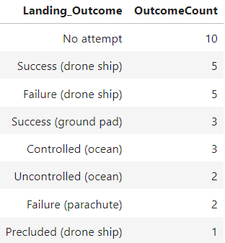
EDA with SQL
SQL Queries:
9. List the records which will display the month names, succesful landing_outcomes in ground pad, booster versions, launch_site for the months in year 2017
%sql SELECT substr(Date, 6, 2) AS Month, Landing_Outcome, Booster_Version, Launch_Site FROM SPACEXTABLE WHERE substr(Date, 0, 5) = '2017' AND Landing_Outcome = 'Success (ground pad)';
10. Rank the count of landing outcomes (such as Failure (drone ship) or Success (ground pad)) between the date 2010-06-04 and 2017-03-20, in descending order
%sql SELECT Landing_Outcome, COUNT(*) AS OutcomeCount FROM SPACEXTABLE WHERE Date BETWEEN '2010-06-04' AND '2017-03-20' GROUP BY Landing_Outcome ORDER BY OutcomeCount DESC;
EDA with SQL Notebook:
https://github.com/WarDen-Git/testrepo/blob/main/jupyter-labs-eda-sql-edx_sqllite.ipynb

Slide 17

Build an Interactive Map with Folium
Folium.marker
Purpose: Used to place markers on the map at specific locations.
Markers were added to highlight specific points of interest or locations on the map. These markers often contain pop-up information to provide details about the marked location.
Folium.circle
Purpose: Creates circular shapes on the map.
Circles were added to represent areas of interest or influence, providing a visual representation of a defined radius around a central point. This is useful for displaying regions or zones on the map.
MarkerCluster
Purpose: Groups nearby markers into clusters to improve map readability.
When there are numerous markers in close proximity, MarkerCluster helps organize and display them dynamically. As users zoom in, the clusters break apart to reveal individual markers, preventing map clutter.
MousePosition
Purpose: Displays the coordinates of the mouse pointer on the map.
MousePosition was added to provide real-time latitude and longitude information as users move their cursor across the map. This can be helpful for precise location identification.
Folium.polyline
Purpose: Draws lines on the map, connecting specified points.
Polylines were added to illustrate paths or connections between different locations. This is useful for visualizing routes, boundaries, or any sequential relationships on the map.
Launch Sites Locations Analysis with Folium Notebook:
https://github.com/WarDen-Git/testrepo/blob/main/lab_jupyter_launch_site_location.jupyterlite.ipynb

Slide 18
Build a Dashboard with Plotly Dash
Launch Site Drop-down Input Component:
Purpose: Enables the selection of different launch sites from a dropdown menu.
This input component allows users to focus on specific launch sites of interest. It enhances user interactivity by providing a means to filter data based on launch locations, making the dashboard more versatile for users interested in particular sites.
Callback Function for Success Pie Chart:
Purpose: Renders a pie chart visualizing launch success counts based on the selected launch site from the dropdown.
The pie chart provides a quick overview of the distribution of launch successes for the chosen site. This visual representation allows users to easily grasp the success rates and assess the performance of different launch sites.
Range Slider to Select Payload:
Purpose: Allows users to select a payload range using a slider.
The range slider offers a flexible way to filter data based on payload values. Users can easily explore variations in payload ranges and observe any patterns or trends in the dataset related to mission outcomes.
Callback Function for Success-Payload Scatter Plot:
Purpose: Renders a scatter plot visualizing the correlation between payload and mission success for the selected launch site.
The scatter plot aids in exploring potential relationships between payload characteristics and mission outcomes. By dynamically updating based on the selected launch site and payload range, users can visually assess whether certain payload features are associated with higher or lower success rates.
Interactive Dashboard with Plotly Notebook:
https://github.com/WarDen-Git/testrepo/blob/main/Hands_on_Lab__Build_an_Interactive_Dashboard_with_Plotly_Dash.ipynb

Slide 19
Predictive Analysis (Classification)
1. Created a NumPy array (Y) from the 'Class' column in the data to serve as the target variable for classification.
2. Standardized the feature data (X) to ensure uniform scale and prevent any single feature from dominating the model.
3. Split the data into training and test sets using the train_test_split function for evaluating model performance on unseen data.
4. Conducted a hyperparameter search to optimize logistic regression, support vector machine, decision tree, and k-nearest neighbor classifiers.
5. Computed accuracy and generated confusion matrices for each classifier to assess their performance on the dataset.
6. Identified the best-performing model based on the evaluation metrics, selecting the classifier with the highest accuracy or meeting specific performance criteria.
Predictive Analysis Notebook:
https://github.com/WarDen-Git/testrepo/blob/main/module_4_SpaceX_Machine_Learning_Prediction_Part_5.jupyterlite.ipynb

Slide 20
Results
Exploratory data analysis results
Interactive analytics demo in screenshots
Predictive analysis results

Slide 21

Section 2

Slide 22
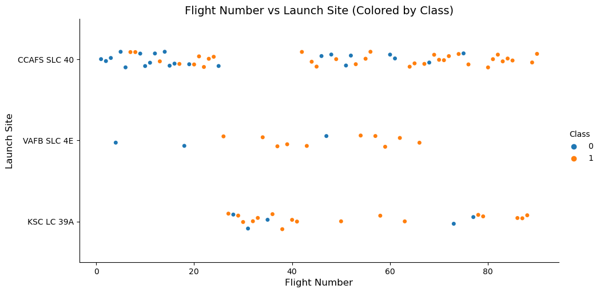
Flight Number vs. Launch Site
If the number of flights exceeds 80, the success rate is 100%.

Slide 23
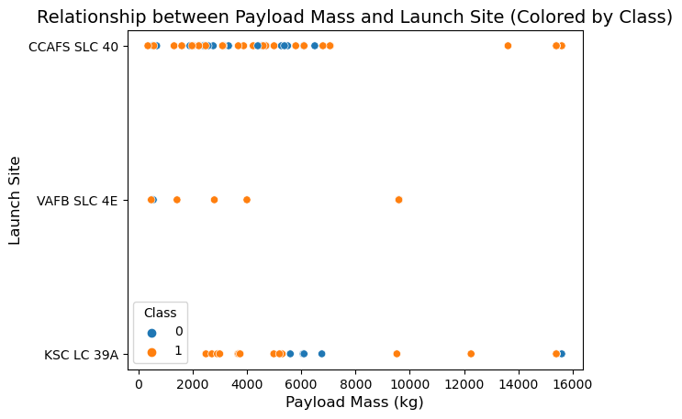
Payload vs. Launch Site
At the VAFB-SLC launch site, no rockets have been launched with a heavy payload mass exceeding 10,000.

Slide 24
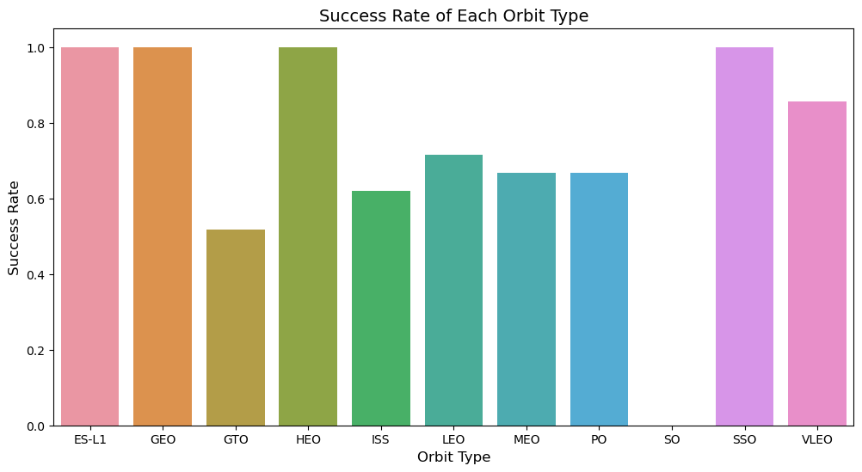
Success Rate vs. Orbit Type
The ES-L1, GEO, HEO, and SSO orbits exhibit the highest success rates.

Slide 25
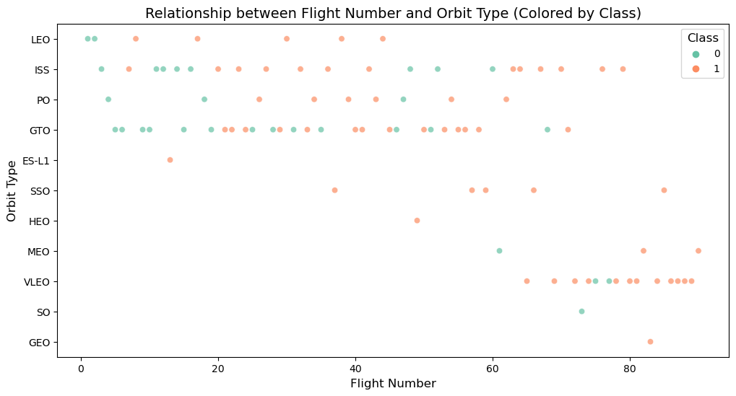
Flight Number vs. Orbit Type
If the number of flights exceeds 80, the success rate is 100%.

Slide 26
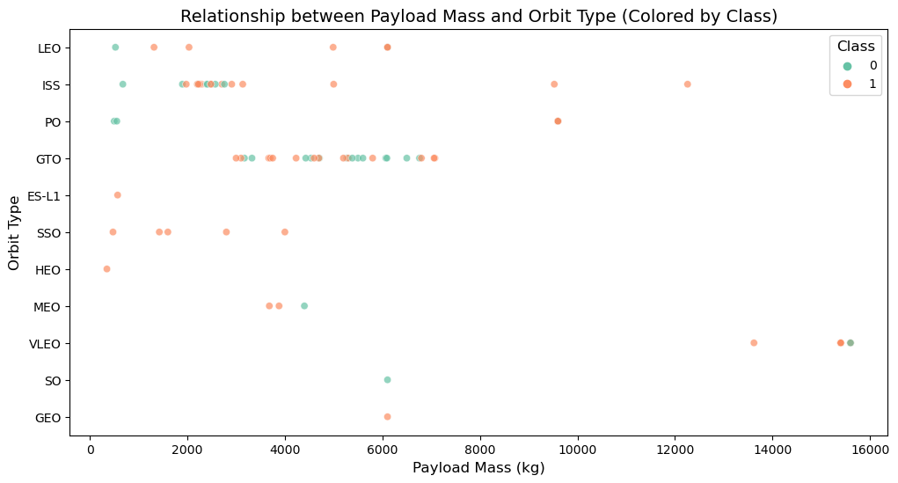
Payload vs. Orbit Type
For heavy payloads, Polar, LEO, and ISS orbits show a higher rate of successful landings. However, distinguishing the landing outcomes is less clear for GTO, as both positive landing rates and negative landing (unsuccessful mission) rates are observed in this orbit.

Slide 27
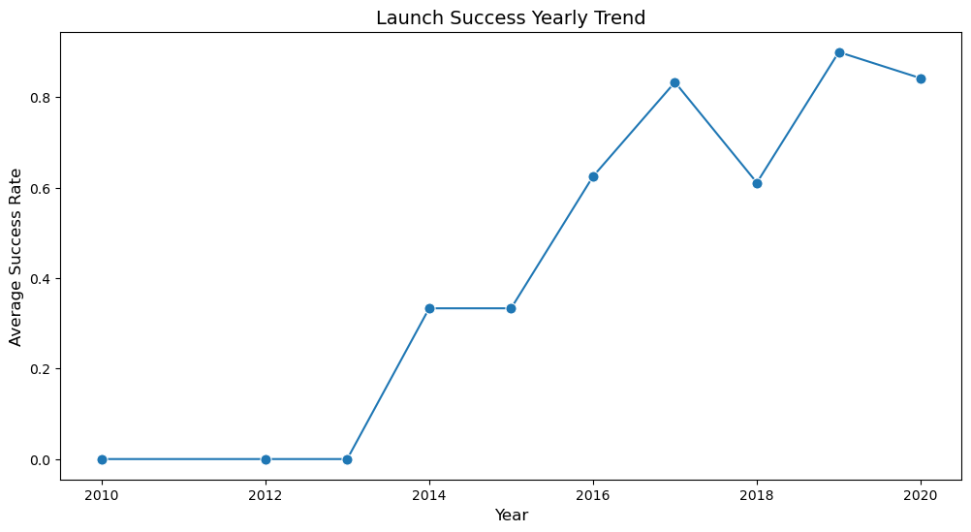
Launch Success Yearly Trend
The success rate has been consistently increasing from 2013 until 2020.

Slide 28
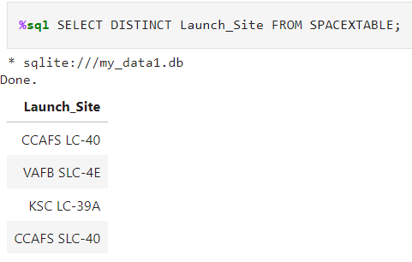
All Launch Site Names
The SQL query %sql SELECT DISTINCT Launch_Site FROM SPACEXTABLE; retrieves a list of unique launch site names from the "Launch_Site" column in the "SPACEXTABLE" table. The use of DISTINCT ensures that only distinct values are returned, eliminating any duplicates in the result set. This query is designed to provide a clear and unique list of launch sites mentioned in the specified column of the table.

Slide 29
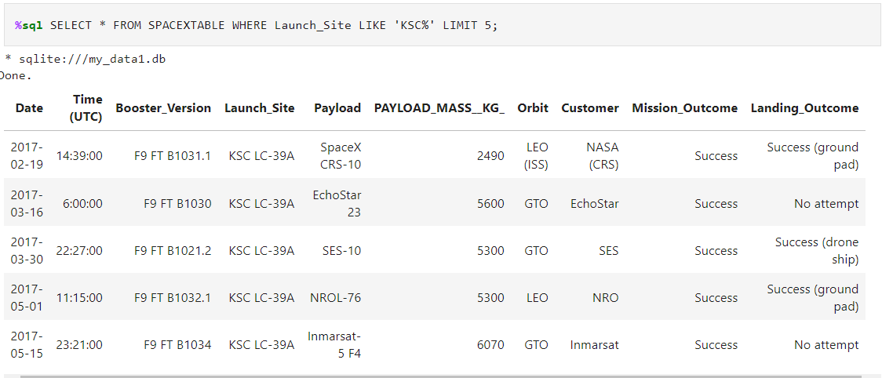
Launch Site Names Begin with 'KSC'
The SQL query %sql SELECT * FROM SPACEXTABLE WHERE Launch_Site LIKE 'KSC%' LIMIT 5; retrieves up to five rows from the "SPACEXTABLE" table where the values in the "Launch_Site" column start with 'KSC'. The LIKE operator, combined with the percent sign (%), is used for pattern matching, and in this case, it filters records where the launch site name begins with 'KSC'. The LIMIT 5 statement ensures that only a maximum of five results are returned. This query provides a snapshot of the first five records in the table that meet the specified criteria related to the launch site.

Slide 30
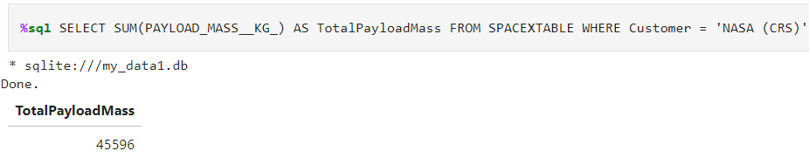
Total Payload Mass
The SQL query %sql SELECT SUM(PAYLOAD_MASS__KG_) AS TotalPayloadMass FROM SPACEXTABLE WHERE Customer = 'NASA (CRS)' calculates the total payload mass, represented by the "PAYLOAD_MASS__KG_" column, for missions where the customer is identified as 'NASA (CRS)' in the "SPACEXTABLE" table. The SUM function is used to aggregate the payload masses of all relevant rows, and the result is given an alias "TotalPayloadMass" for clarity. This query allows for the retrieval of the cumulative payload mass specifically associated with NASA Commercial Resupply Service (CRS) missions in the dataset.

Slide 31
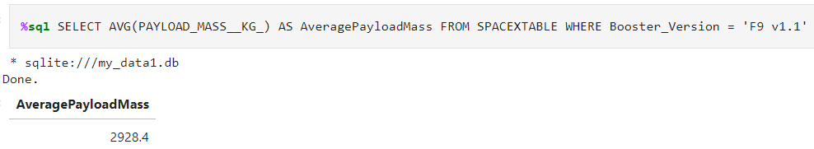
Average Payload Mass by F9 v1.1
The SQL query %sql SELECT AVG(PAYLOAD_MASS__KG_) AS AveragePayloadMass FROM SPACEXTABLE WHERE Booster_Version = 'F9 v1.1' calculates the average payload mass, represented by the "PAYLOAD_MASS__KG_" column, for missions where the booster version is specified as 'F9 v1.1' in the "SPACEXTABLE" table. The AVG function is used to compute the average of payload masses across all relevant rows, and the result is assigned the alias "AveragePayloadMass" for clarity. This query provides the mean payload mass specifically for missions utilizing the Falcon 9 (v1.1) booster version in the dataset.

Slide 32
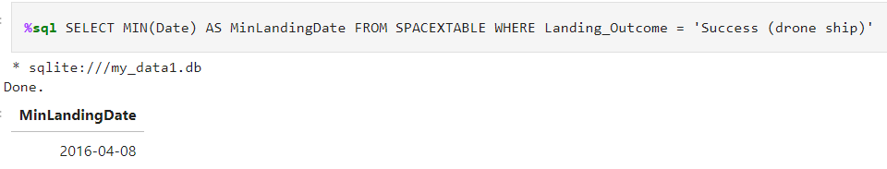
First Successful Ground Landing Date
The SQL query %sql SELECT MIN(Date) AS MinLandingDate FROM SPACEXTABLE WHERE Landing_Outcome = 'Success (drone ship)' retrieves the minimum (earliest) landing date, represented by the "Date" column, among missions where the landing outcome is specified as 'Success (drone ship)' in the "SPACEXTABLE" table. The MIN function is used to find the minimum date value in the subset of rows that meet the specified landing outcome criteria. The result is given the alias "MinLandingDate" for clarity, providing the earliest successful drone ship landing date recorded in the dataset.

Slide 33
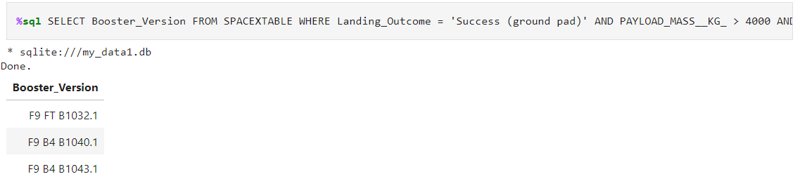
Successful Drone Ship Landing with Payload between 4000 and 6000
The SQL query %sql SELECT Booster_Version FROM SPACEXTABLE WHERE Landing_Outcome = 'Success (ground pad)' AND PAYLOAD_MASS__KG_ > 4000 AND PAYLOAD_MASS__KG_ < 6000 retrieves the "Booster_Version" values from the "SPACEXTABLE" table where the landing outcome is specified as 'Success (ground pad)' and the payload mass falls within the range of 4000 to 6000 kilograms. This query filters the dataset to specifically identify booster versions associated with successful ground pad landings and payloads within the specified mass range.

Slide 34
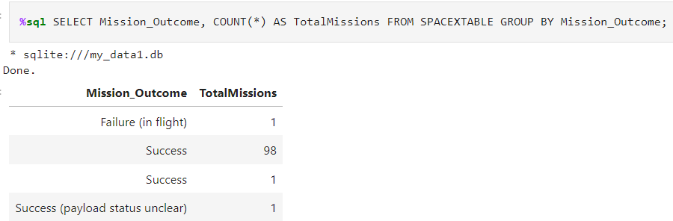
Total Number of Successful and Failure Mission Outcomes
The SQL query %sql SELECT Mission_Outcome, COUNT(*) AS TotalMissions FROM SPACEXTABLE GROUP BY Mission_Outcome; retrieves a summary of mission outcomes and their respective counts from the "SPACEXTABLE" table. The COUNT(*) function is used to calculate the total number of occurrences for each unique value in the "Mission_Outcome" column. The GROUP BY Mission_Outcome statement ensures that the counting operation is performed for each distinct mission outcome. The result will show a list of unique mission outcomes alongside the total count of missions associated with each outcome in the dataset.

Slide 35
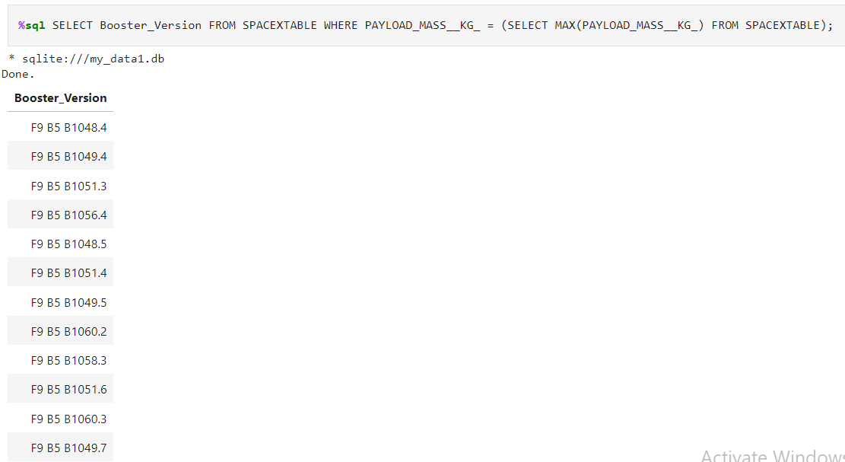
Boosters Carried Maximum Payload
The SQL query %sql SELECT Booster_Version FROM SPACEXTABLE WHERE PAYLOAD_MASS__KG_ = (SELECT MAX(PAYLOAD_MASS__KG_) FROM SPACEXTABLE); retrieves the "Booster_Version" values from the "SPACEXTABLE" table for missions where the payload mass is equal to the maximum payload mass found in the entire dataset. The subquery (SELECT MAX(PAYLOAD_MASS__KG_) FROM SPACEXTABLE) calculates the maximum payload mass, and the outer query filters records where the payload mass matches this maximum value. This query identifies the booster version associated with the mission(s) having the highest payload mass in the dataset.

Slide 36
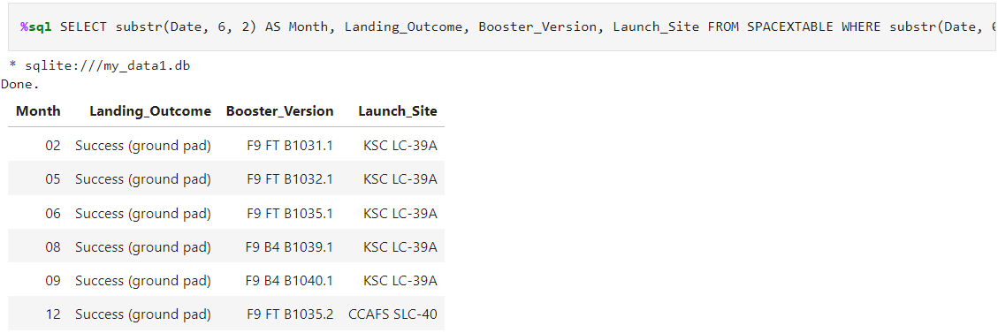
2017 Launch Records
The SQL query %sql SELECT substr(Date, 6, 2) AS Month, Landing_Outcome, Booster_Version, Launch_Site FROM SPACEXTABLE WHERE substr(Date, 0, 5) = '2017' AND Landing_Outcome = 'Success (ground pad)'; retrieves a subset of data from the "SPACEXTABLE" table for missions that occurred in the year 2017 and had a landing outcome specified as 'Success (ground pad)'. The substr(Date, 6, 2) extracts the month information from the "Date" column, and the selected columns include the extracted month, landing outcome, booster version, and launch site for these specific missions.

Slide 37
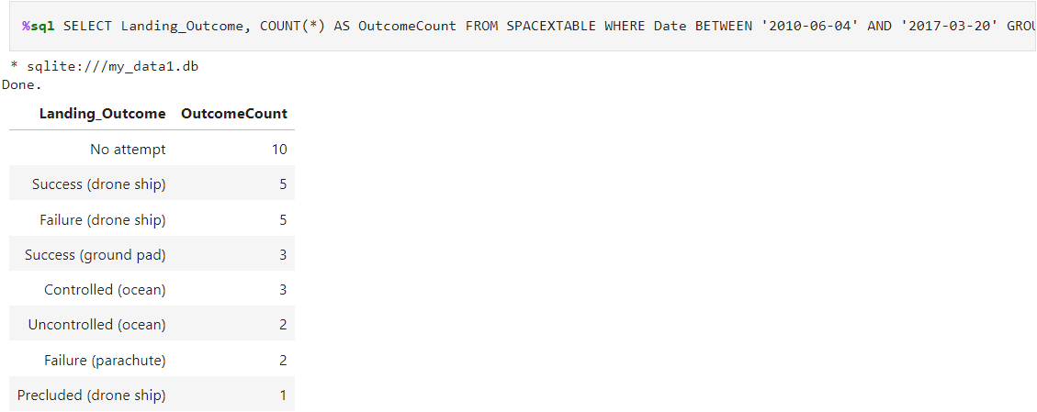
Rank Landing Outcomes Between 2010-06-04 and 2017-03-20
The SQL query %sql SELECT Landing_Outcome, COUNT(*) AS OutcomeCount FROM SPACEXTABLE WHERE Date BETWEEN '2010-06-04' AND '2017-03-20' GROUP BY Landing_Outcome ORDER BY OutcomeCount DESC; retrieves a summary of landing outcomes and their respective counts from the "SPACEXTABLE" table for missions that occurred between June 4, 2010, and March 20, 2017. The COUNT(*) function calculates the total number of occurrences for each unique value in the "Landing_Outcome" column, and the GROUP BY Landing_Outcome ensures the counting operation is performed for each distinct landing outcome. The result is then ordered in descending order based on the count of each landing outcome, providing a ranking of outcomes from the most to the least frequent during the specified time range.

Slide 38

Section 3

Slide 39
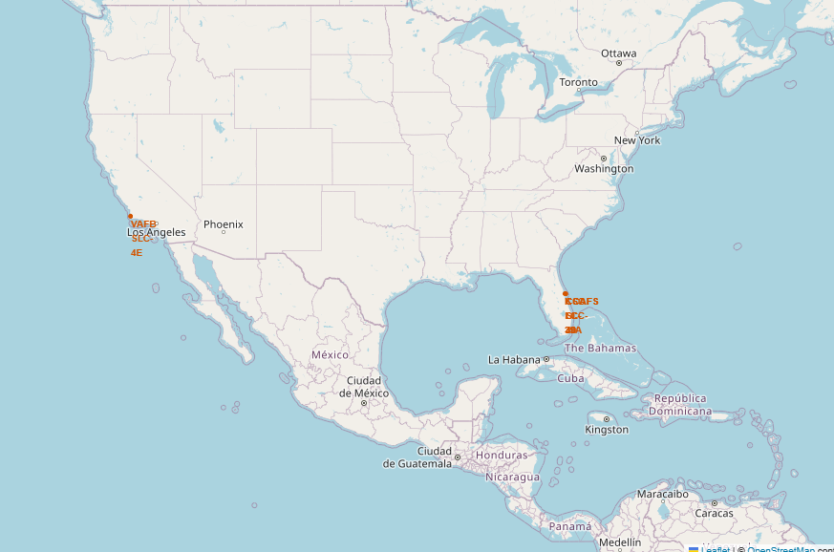
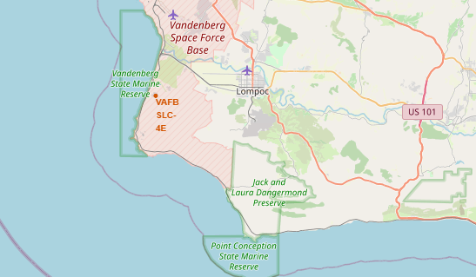
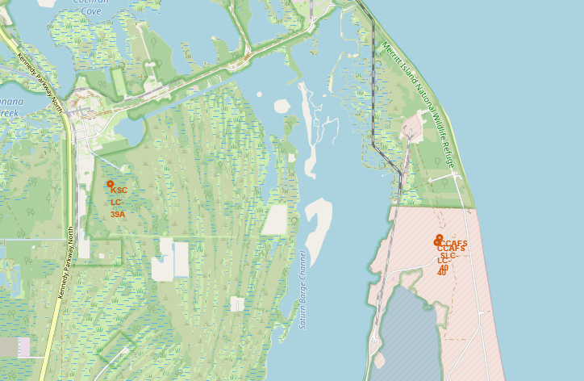
All Launch Sites
All launch sites are situated in close proximity to the coast and within restricted areas.

Slide 40
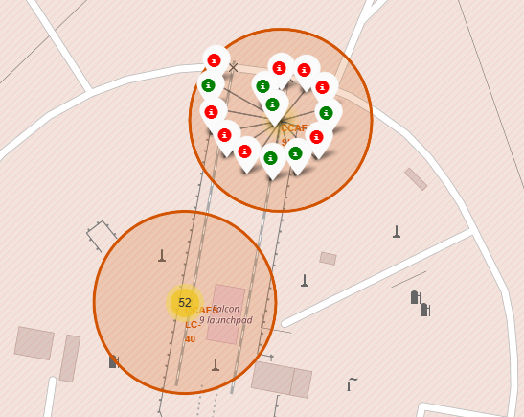
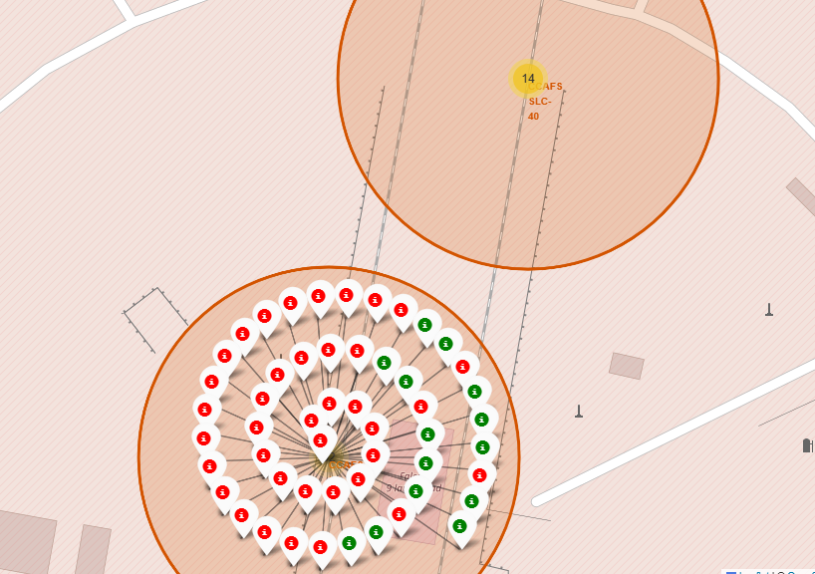
Success/Failed Launches For Each Site
Green marker indicates that a launch was successful. Otherwise, red marker means that the launch was failed.

Slide 41
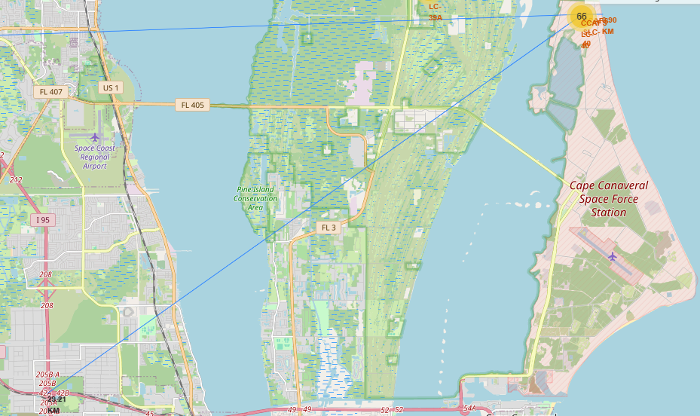
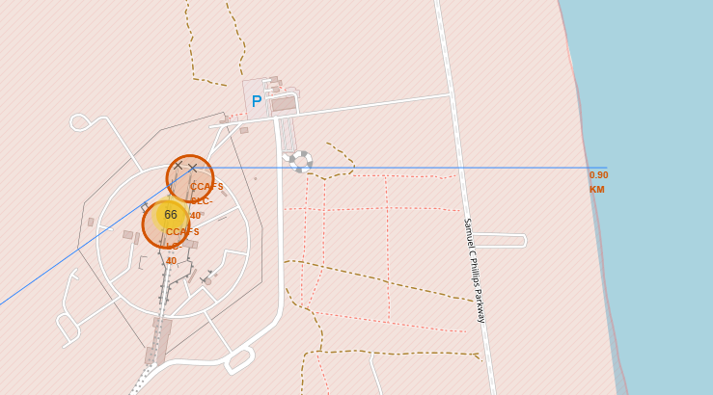
A Launch Site and its Proximities
Launch sites are near to railways, roads, highways and coastline.

Slide 42

Section 4

Slide 43

Pie chart showing the success percentage achieved by each launch site
Based on chart, we conclude that KSC LC-39A has the highest number of successful launches among all the launch sites.

Slide 44
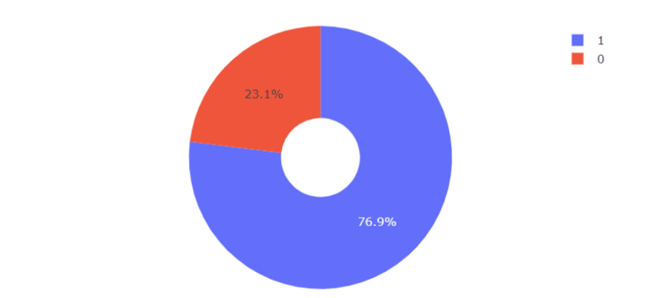
Pie chart showing the Launch site with the highest launch success ratio
The success rate for launches from KSC LC-39A is 76.9%.

Slide 45
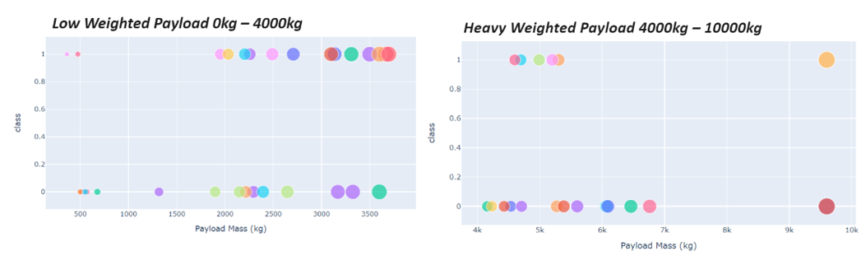
Scatter plot of Payload vs Launch Outcome for all sites, With different payload selected in the range slider
The analysis indicates that the success rate is higher for missions with lower payload weights compared to those with higher payload weights.
45

Slide 46

Section 5

Slide 47
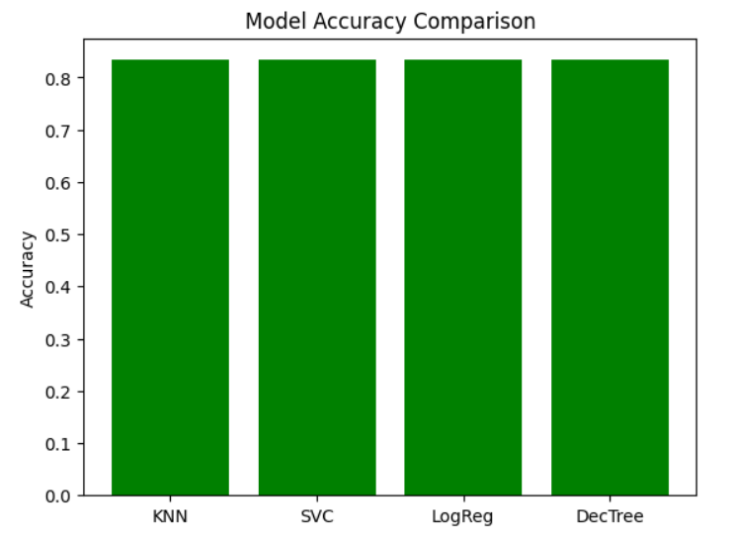
Classification Accuracy
All machine learning algorithms tested, including KNN, Logistic Regression, Support Vector Machine (SVM), and Decision Tree, exhibited identical accuracy levels for this task.

Slide 48
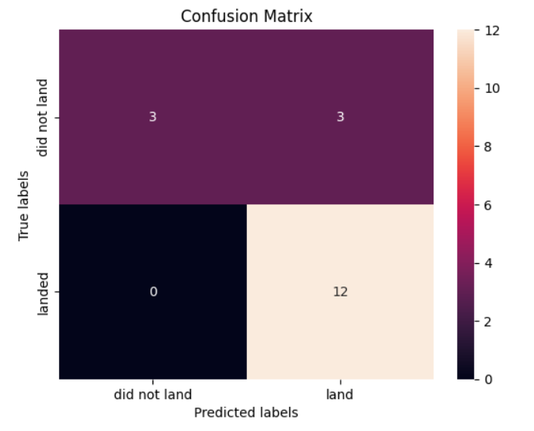
Confusion Matrix
The 4 models show strength in true positive predictions and true negatives, there is room for improvement in reducing false negatives to enhance overall performance, depending on the specific goals and requirements of the classification task.

Slide 49
Conclusions
Launch Site Flight Amount Impact: An observed trend indicates that a launch site's success rate is positively correlated with the volume of flights conducted at that site. In other words, sites with more frequent launches tend to have higher success rates.
Temporal Success Rate Trend: The launch success rate exhibited an upward trajectory starting in 2013 and continued until 2020. This temporal analysis suggests an improvement in overall launch success during this period.
Orbit-specific Success Rates: Among various orbits, including ES-L1, GEO, HEO, SSO, and VLEO, launches into these specific orbits demonstrated notably higher success rates. This highlights the significance of considering the target orbit when assessing launch success.
Top Performing Launch Site: KSC LC-39A stands out as the launch site with the most successful launches. This site consistently achieved a high level of success, indicating its reliability in hosting successful launch missions.
Machine Learning Algorithm Performance: All machine learning algorithms tested, including KNN, Logistic Regression, Support Vector Machine (SVM), and Decision Tree, exhibited identical accuracy levels for this task. This suggests that, within the context of this specific predictive task, these algorithms perform equally well and yield the same level of accuracy. Consequently, the choice of algorithm may be based on other considerations such as interpretability, computational efficiency, or specific requirements of the task at hand, given the absence of discernible accuracy differences among these models.

Slide 50

Appendix
For notebooks and scripts, follow this GitHub repository link.
https://github.com/WarDen-Git/testrepo

Slide 51


